Slide 1
Real Time System
By: Er. Suvash Chandra Gautam
22 Feb, 2024

Slide 2
Introduction
A real-time system means that the system is subjected to real-time, i.e., the response should be guaranteed within a specified timing constraint or the system should meet the specified deadline. For example flight control systems, real-time monitors, etc.
A real-time system is a type of computer system that processes data or events instantaneously, within a predetermined time frame known as a deadline. These systems are designed to respond to external stimuli or input within a specified time constraint, ensuring that tasks are completed within required timing parameters. Real-time systems are critical in applications where timely and predictable responses are essential, such as industrial automation, aerospace systems, medical devices, and financial trading platforms.

Slide 3
Real-time systems are computing systems that are subject to real-time constraints, meaning they must respond to external events within a specified time frame.
These systems are utilized in various domains such as aerospace, automotive, industrial control, healthcare, and multimedia.
Real-time systems are classified into two main categories: hard real-time systems and soft real-time systems.

Slide 4
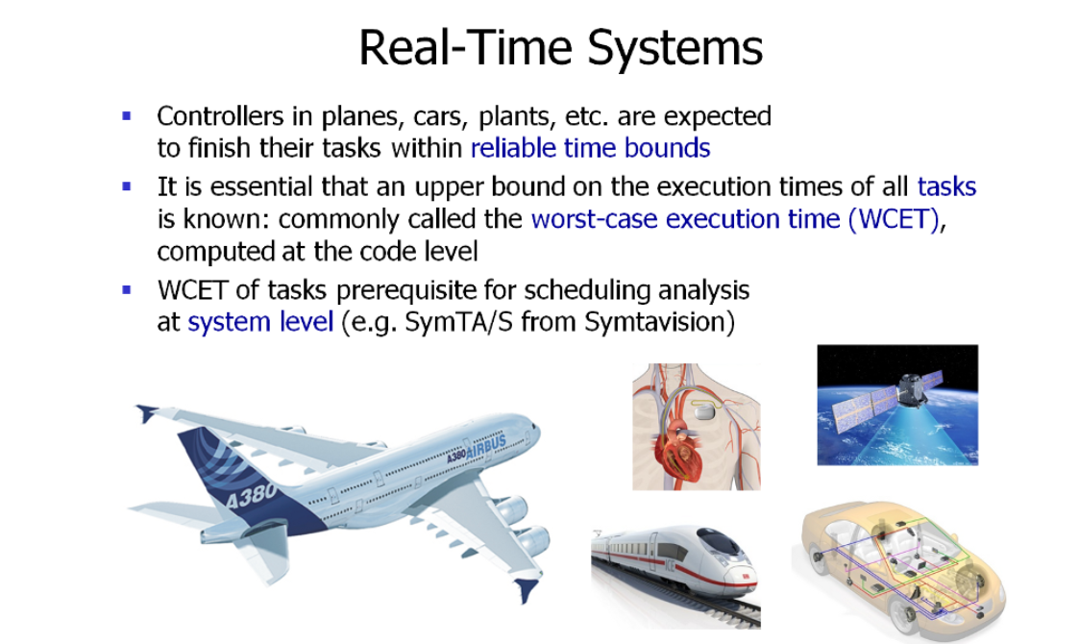

Slide 5
Real-Time System is used at those Places where we require higher and timely responses. Real-time operating systems involve a set of applications where the operations are performed on time to run the activities in an external system. It uses the quantitative expression of time to analyze the system's performance.
The deadline in the context of a real-time system is the moment of the time by which the job's execution is needed to be accomplished. Most real-time operating systems use a pre-emptive scheduling algorithm.

Slide 6
A real-time operating system (RTOS) is intended to serve real-time applications that process data without buffer delays.
A real-time system is a time-bound system with well-defined and fixed time constraints, and processing must be done within the defined constraints; otherwise, the system will fail.
In a real-time operating system, processing time requirements are measured in tenths of seconds.

Slide 7
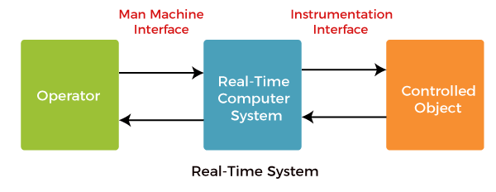

Slide 8
Examples of Real-Time Operating Systems
The operating system of the microwave oven.
The operating system of the Washing machine.
The operating system of the aero plane.
The operating system of digital cameras and many more.
The quick response of the process is a must in real-time operating systems. There is no chance of any delay in completing any process because a little delay can cause several dangerous issues.

Slide 9
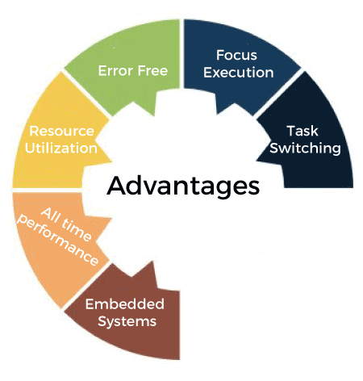

Slide 10
Task switching: Real-time operating systems are designed, so that starting switching is a very quick process. A normal traditional operating system takes a lot of time while switching from one person to another process. The real-time operating system completes the task switching only within some of the microseconds.
Focus execution: The main focus of real-time operating systems is to handle the task in execution, and just a little focus is on the task in waiting.
Error-free: Real-time operating systems are designed very carefully, and different kinds of software testing techniques are applied to the real-time operating system to test the system. This detailed testing makes the real-time operating system approximately error-free.

Slide 11
Maximum resource utilization: Real-time operating systems are designed to follow the task within a given time secretly. This is not simple and easy to complete the task within time.
The real-time operating system utilizes all the hardware efficiently and completely. The main focus of the real-time operating system is not to save energy or resources.
So we can see that the real-time operating system utilize the resources completely and very efficiently.
Usage in embedded systems: Real-time operating systems can also work with embedded systems.
All-time performance: Real-time operating systems are designed to works 24 hours a day and every day.

Slide 12
Types of Real-Time System
A real-time operating system is divided into two systems, such as:
Hard real-time system
Soft real-time system
Hard and Soft real-time systems are the variants of real-time systems where the hard real-time system is more restrictive than the soft real-time system. The hard real-time system must assure to finish the real-time task within the specified deadline. While this is not the case in the soft real-time system, it assigns superior scheduling priority to real-time tasks.

Slide 13
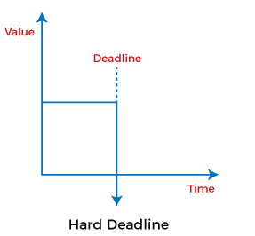
Hard Real-Time System
A hard real-time system considers timelines as a deadline, and it should not be omitted in any circumstances. Hard real-time Systems do not use any permanent memory, so their processes must be complete properly in the first time itself.
Hard Real-Time System must generate accurate responses to the events within the specified time. A hard real-time system is a purely deterministic and time constraint system.

Slide 14
For example, users expected the output for the given input in 5 sec then the system should process the input data and give the output exactly by the 5th second.
It should not give the output by the 6th second or by the 4th second.
Here above 5 seconds is the deadline to complete the process for given data.
In the hard real-time system, meeting the deadline is very important if the deadline is not met, the system performance will fail.

Slide 15
Examples of Hard Real-Time Systems
Flight Control Systems
Missile Guidance Systems
Weapons Defense System
Medical System
Inkjet printer system
Railway signalling system
Air traffic control systems
Nuclear reactor control systems
Anti-missile system
Chemical plant control
Autopilot System in Plane

Slide 16
Soft Real-Time System
A soft real-time system is a system whose operation is degraded if results are not produced according to the specified timing requirement.
In a soft real-time system, the meeting of deadline is not compulsory for every task, but the process should get processed and give the result.
Even the soft real-time systems cannot miss the deadline for every task or process according to the priority it should meet the deadline or miss the deadline.

Slide 17
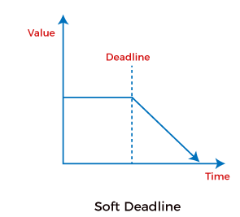

Slide 18
If a system is missing the deadline every time, the system's performance will be worse and cannot be used by the users. The best example for the soft real-time system is a personal computer, audio and video systems, etc.
Soft real-time systems consider the processes as the main task and control the entire task.

Slide 19
Examples of Soft Real-Time Systems
Here are some common examples of soft real-time operating systems, such as:
Personal computer
Audio and video systems
Set-top boxes
DVD Players
Weather Monitoring Systems
Electronic games
Multimedia system
Web browsing
Online transaction systems
Telephone switches
Virtual reality
Mobile communication

Slide 20
Firm Real-Time System
These are systems that lie between hard and soft real-time systems. In firm real-time systems, missing a deadline is tolerable, but the usefulness of the output decreases with time. Examples of firm real-time systems include online trading systems, online auction systems, and reservation systems.
A firm real-time system is one in which a few missed deadlines will not lead to total failure, but missing more than a few may lead to complete or catastrophic system failure.

Slide 21
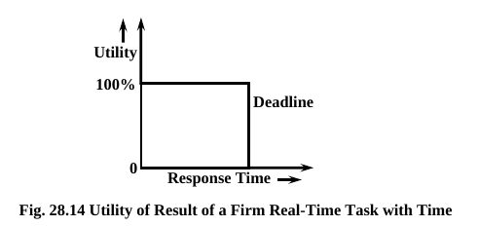

Slide 22
Every firm real-time task is associated with some predefined deadline before which it is required to produce its results.
However, unlike a hard real-time task, even a firm real-time task does not complete within its deadline, the system doesn’t fail but the late results are merely discarded.
In other words, the utility of the results computed by a firm real-time task becomes zero after the deadline.
Examples: A video conferencing application, Satellite-based surveillance applications

Slide 23
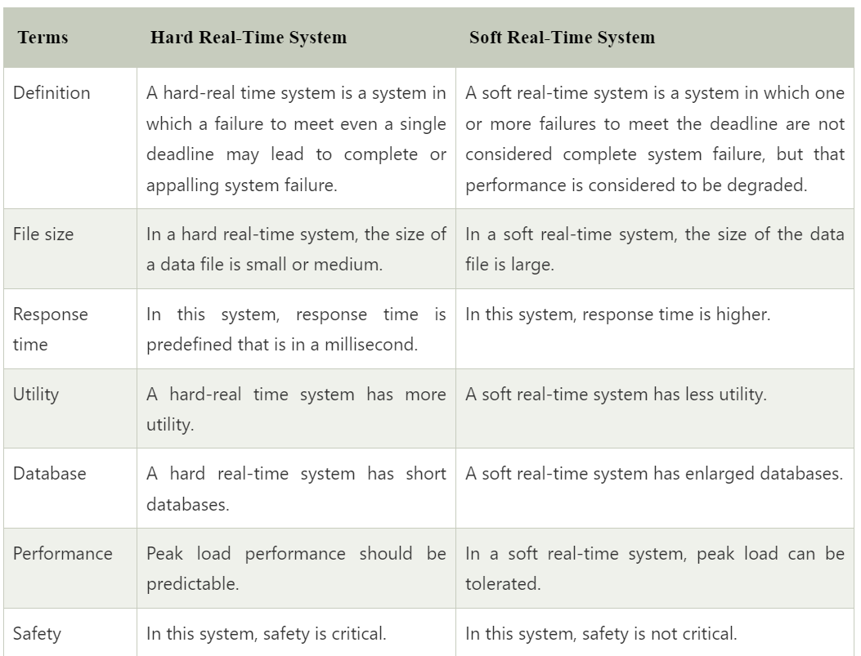

Slide 24
